Slide 1

Book Management System
Presented By:
Krishna Gupta (21107024) Himanshu Maurya (21107038)
Meris Gada (21107041) Tushar Goud (21107027)
Project Guide
Ms. Poonam Pangarkar

Slide 2
Contents
Introduction
Objectives
Features
Built in functions used
Block Diagram
Output Screenshots

Slide 3
1. Introduction
This project is on a Book Management System which deals with almost all the information of a bookshop.
It keeps the Book-title, price, and edition of books.
The proposed system is a window-based menu-driven system.
It reduces the paper work, the time needed for doing various tasks, etc.
This project upholds the accuracy of data.

Slide 4
2. Objectives
To search records of books efficiently.
Processing large amounts of data effectively and efficiently.
To provide better service.
It is the easiest way to maintain book record data.

Slide 5
3. Feature
Easy to record all the data about the Books and their details.
It saves time for the user as well as prevents paperwork.
It provides security to the database which is a large amount of important data for the Book Shop.

Slide 6
4. Block Diagram/ Flow diagram
Login
Dashboard
Enter Book Details
CRUD Operations
Output

Slide 7
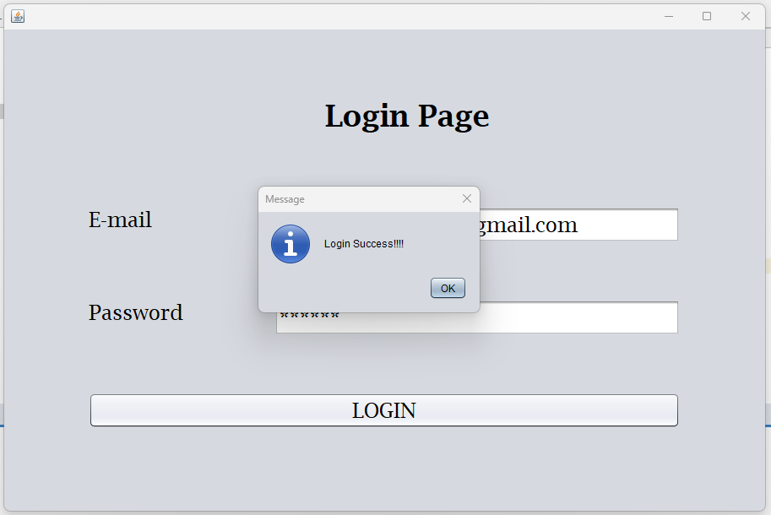
5. Output of Project

Slide 8
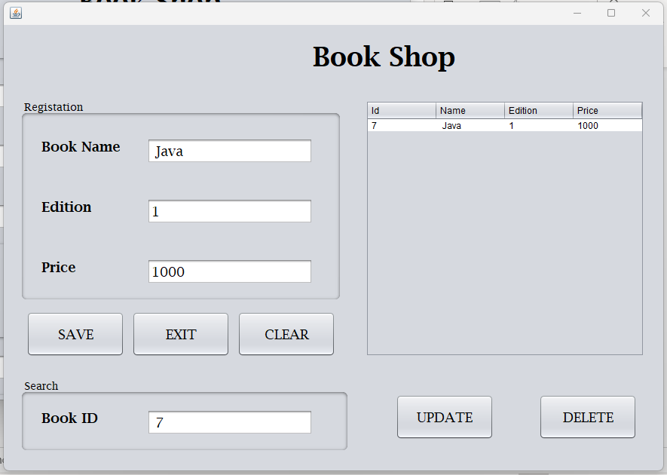
5. Output of Project

Slide 9
Thank You...!!!

